Slide 1
Movie Ticket Booking Application

Slide 2
Technologies
Java 8
Spring Boot
Spring Security
Angular | React
PostgreSQL | MYSQL
Maven | Gradle

Slide 3
Problem Statement
To Create an Application for online Movie Ticket booking
Customer should be able to view the list of movies, Theatre, screen and available shows.
Customer should be able to buy the tickets for desired show.
Admin should be able to perform below operations:
1.Movie Management
2.Theatre management
3.Screen management

Slide 4
Plan
Design
Generate the skeleton as per class design provided
TDD approach
Identify test cases for each module
Write Failing Test cases
Convert the Test Cases in GREEN
Implement the case study in incremental manner

Slide 5
Modules
Login Module
Passenger Module
Flight
Management Module
Screen Management Module
Ticket Booking
Management Module
Theatre Management module

Slide 6
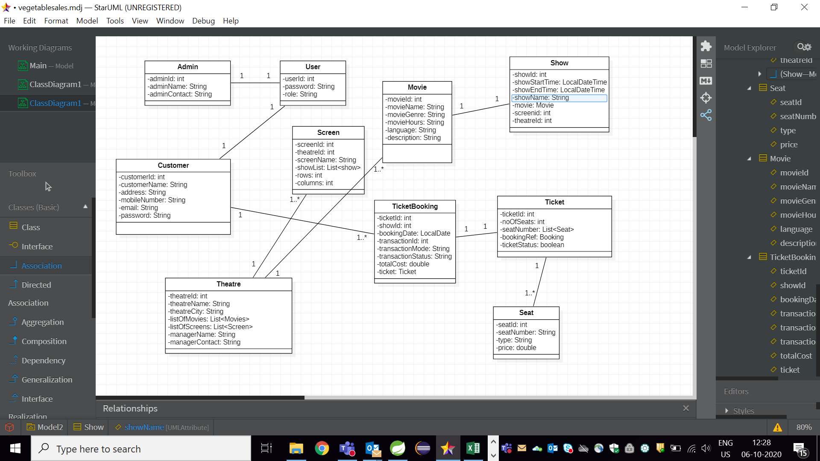
Class Design [POJO Classes]

Slide 7
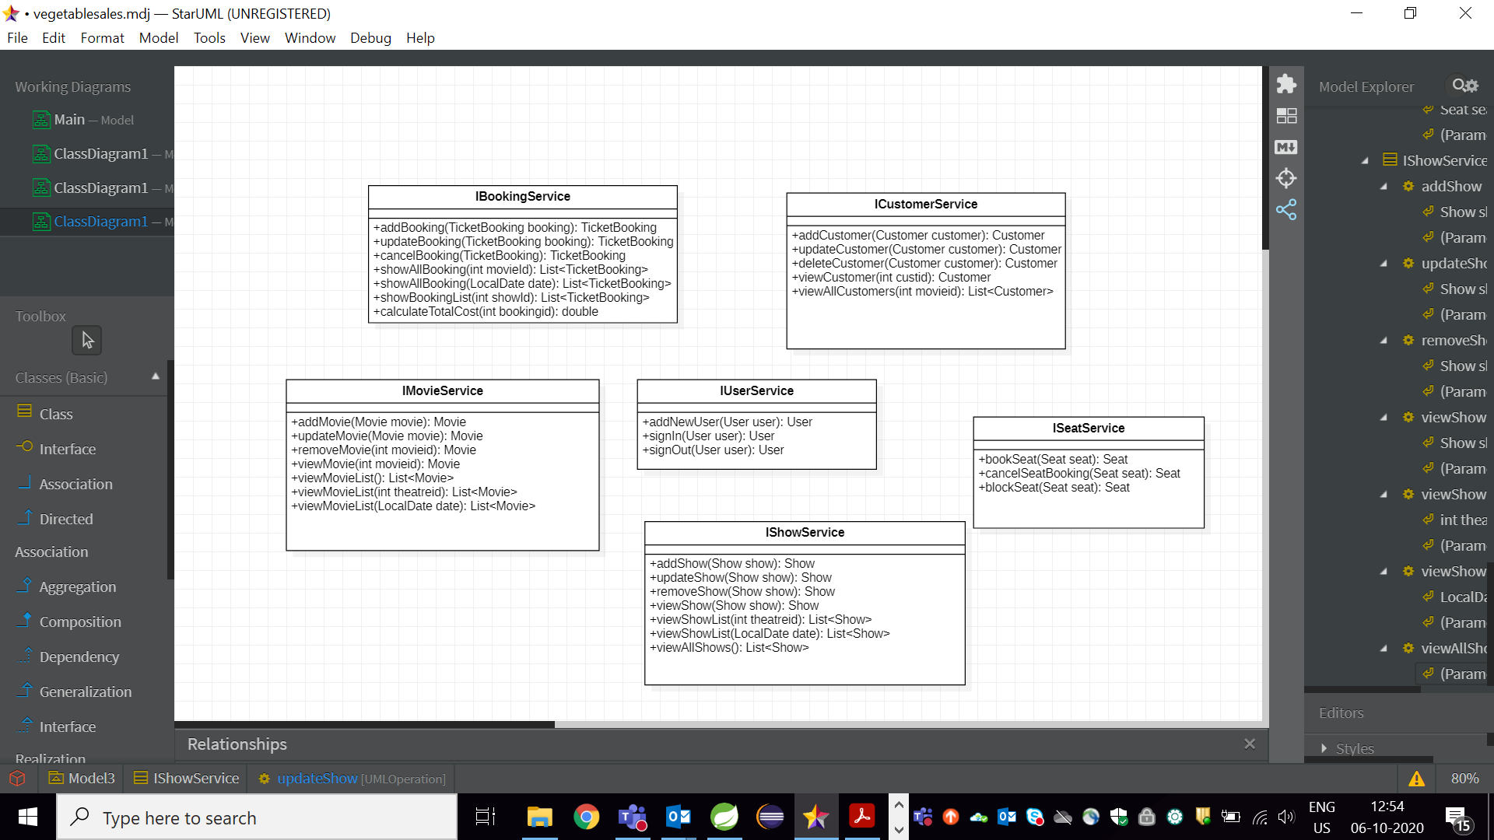
Class Design [Service Interface]

Slide 8

Class Design [Repository]

